Slide 1
Surface detection from Image
Team
1.College Professor(s): Dr. Rajarajeswari S and Dr. Sini Anna Alex
2.Samsung Mentor: Akhilesh Parmar
3.Students:
i) Haarish Anandan(CSE)
ii) Tejas Hedge(CSE)
iii) Rahul Kumar(ECE)
iv) Satyam Satyarthi(ECE)
v) Pranamya Kashyap MP( PG _ CSE)

Slide 2
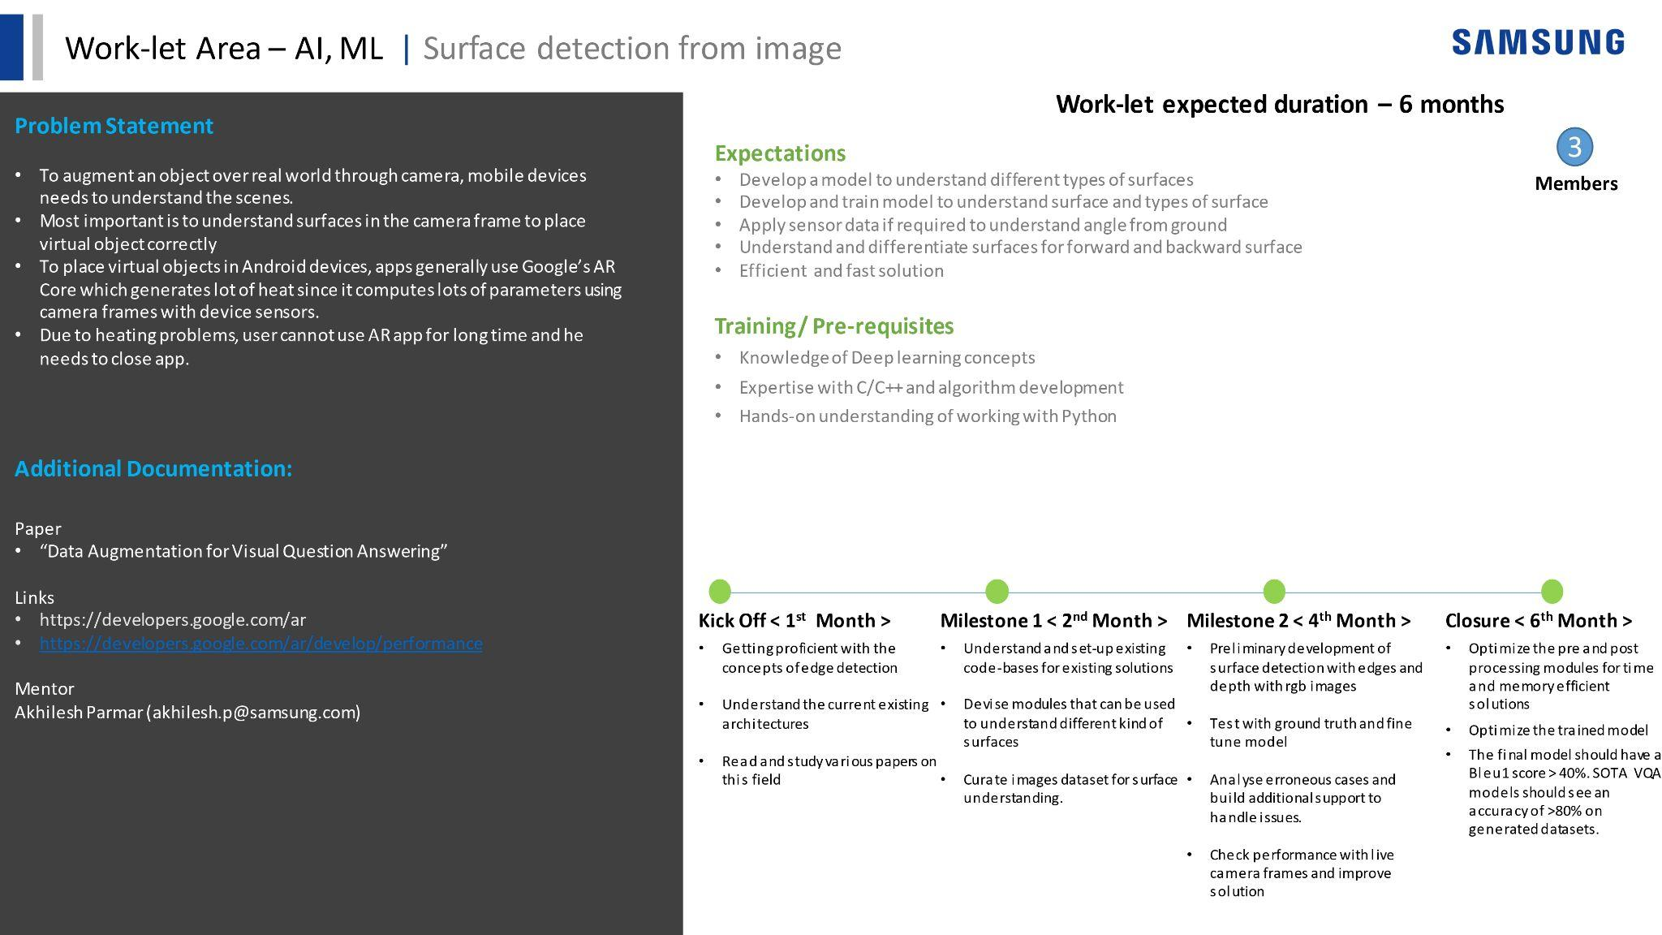

Slide 3
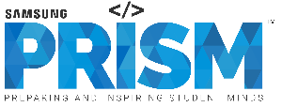
Work-let Name: Surface detection from image
Worklet Details
Worklet ID: ATL_23
College Name: Ramaiah Institute of Technology
KPIs achieved till now
Procured dataset for Surface Classification (Flat - 463 , Vertical - 474 , Slant - 203).
Trained an image classifier with loss = 0.38 and accuracy = 96.4%.
Procured dataset for Image Segmentation (Training - 120 images , Validation - 5 images , Testing - 30 images).
Trained image segmentation model using PSPNet and DeepLab-lite and obtained initial accuracy of about 58%.
Trained a Mask RCNN model with 82% accuracy score and 84% Jacquard Index on validation set.
Trained Deeplab MobileNetv2 model with loss=0.91.
Built Image Segmenter Android App with inference time in ms.

Slide 4
Work-let Name: Surface detection from image
Any Challenges/ Issues faced
Manual dataset preparation process.
Distinguishing between vertical surface and horizontal surface with respect to close-up shot of surfaces
Manual segmentation and labelling of images (very time consuming) necessary for training the model
Outdated code had to updated from scratch. Unable to update accuracy measurement code.
Lack of relevant documentation.
High RAM required to run code.
Tweaking the dataset in order to have background too. This was done to facilitate proper training of the Deeplab model.
Real time Angle detection put a heavy burden on the mobile device.
Worklet ID: ATL_23
College Name: Ramaiah Institute of Technology

Slide 5
Work-let Name: Surface detection from image
Expand dataset by adding and segmenting more images.
More iterations for better accuracy.
Use of powerful GPU’s to facilitate greater batch size during training.
Analyze structure of Mask RCNN and DeepLab for further improvements.
Angle incorporation has to be done with the app using various sensors so as to get a better knowledge of angle of device with the surface.
Worklet ID: ATL_23
College Name: Ramaiah Institute of Technology
Possible Future Improvements

Slide 6
Work-let Name: Surface detection from image
Procured a dataset for classifying surface types.
Trained a classifier on classification surface dataset.
Procured a dataset for semantic(pixel level) image segmentation.
Rebuilt the DeepLab framework to train on segmentation datasets such as PASCAL VOC dataset.
Produced code that converts our dataset into COCO format.
Added code to make our dataset compatible with the DeepLab framework.
Able to segment images into various surfaces having a background too.
Able to develop a mobile app which can segment images into different surfaces at realtime and display different surfaces with different colors.
Key Achievements/ Outcome till now
Worklet ID: ATL_23
College Name: Ramaiah Institute of Technology

Slide 7
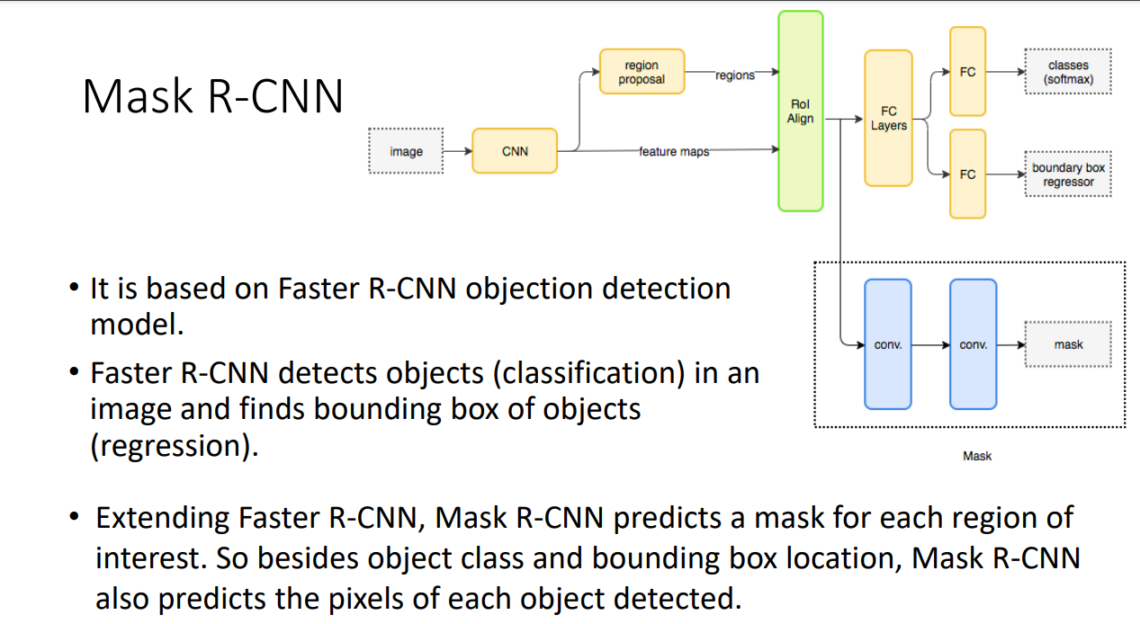

Slide 8
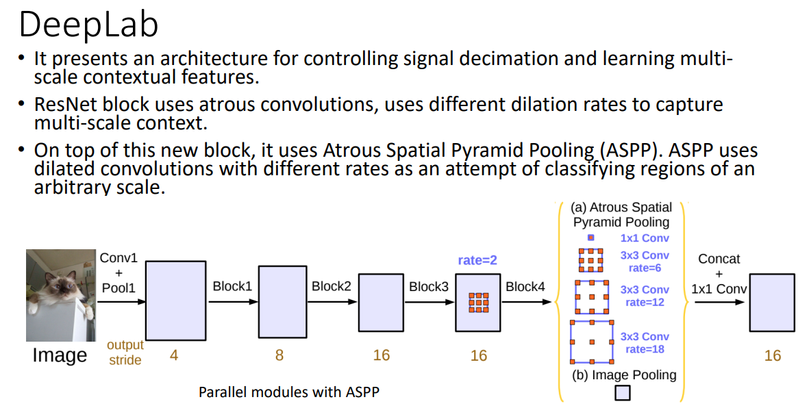

Slide 9
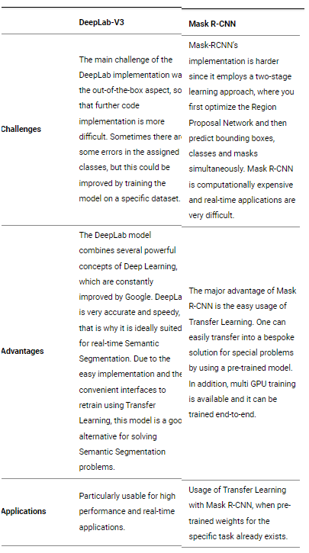
Comparison b/w Deeplab and MaskRCNN

Slide 10
Our Dataset:
The dataset can be divided into three parts: train, validation and test.
Train: Consists of 118 segmented images
Validation: Consists of 5 segmented images
Test: Consists of 30 unsegmented images.
Segmentation was done using segments.ai software. Two separate segments datasets were created one each for train and validation.
Segments.ai supports the modern COCO panoptic/instance segmentation format.
Hence we decided to use the COCO format for our dataset.

Slide 11
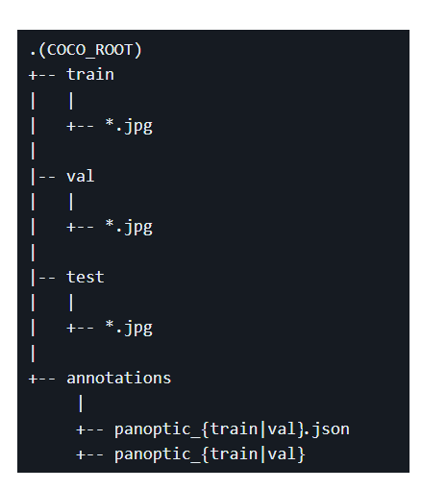
Our Dataset(contd.)
The dataset structure looks as follows:

Slide 12
Mask RCNN
Detectron2 computer vision framework developed by Meta was used to train a Mask RCNN model on our dataset.
We utilized the Detectron2 computer vision framework to train Mask RCNN on our dataset.
We had cloned a repository(fast labelling workflow) which enabled us to easily train the model without any preprocessing and control the amount of epochs.
The training is quite fast. 1500 epochs in 20-25 minutes.
The detectron2 framework also allows us to easily visualize the model predictions.

Slide 13
Deeplab
Even though Mask RCNN provides good results, it does not provide realtime performance which is required in case of an android app that continuously segments camera input.
Thus we decided to use the Deeplab framework.
Moreover, the focus was to build a model suitable for mobile devices. Hence we decided to use a Mobilenet backbone for the Deeplab architecture.
Our research lead us to two tensorflow repositories: deeplab2 and models(/research/deeplab).
However, the deeplab framework requires preprocessing. This is because all images are converted into a format called tfrecord which is suitable for training.
To obtain a model to be integrated into an android app, we convert the model into a format called tflite.

Slide 14
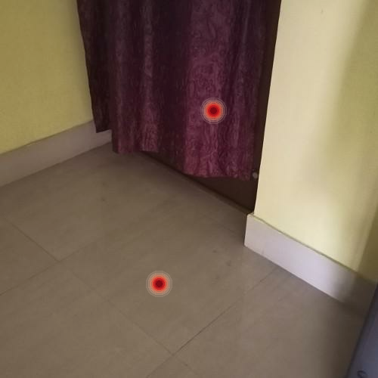
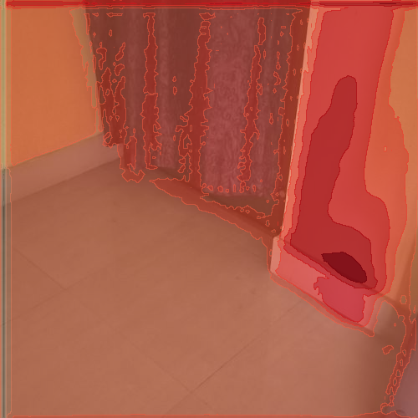
Output produced by Deeplab2

Slide 15
Deeplab
The model trained using deeplab2 was not compatible with tflite format.
Hence we went for the older deeplab framework.
However it does not support COCO format.
Hence we had to convert it into a supported format. PASCAL VOC is one such format.
COCO2VOC tool was used for conversion.
Moreover, the dataset had to be changed from panoptic format to instance format(i.e. Have a background).

Slide 16

Deeplab App Output

Slide 17
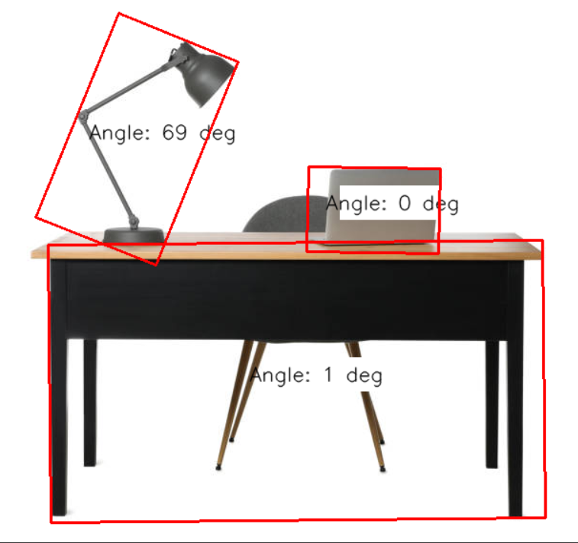
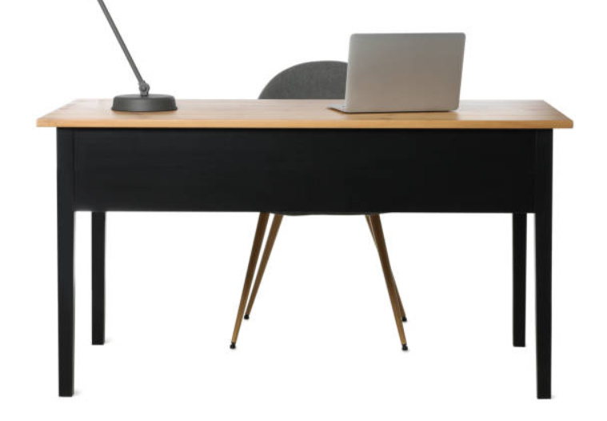
Angle Detection

Slide 18
References:
https://www.researchgate.net/profile/Akilan-Thangarajah/publication/338197556_mask_rcnnpdf/data/5e066097299bf10bc37e2350/mask-rcnn.pdf?origin=publication_list
https://www.novatec-gmbh.de/blog/semantic-segmentation-part-4-state-of-the-art/
https://github.com/McDo/Modanet-DeeplabV3-MobilenetV2-Tensorflow
https://developers.google.com/ar/develop/fundamentals#:~:text=ARCore%20looks%20for%20clusters%20of,information%20available%20to%20your%20app

